Slide 1
Big Data Technology
Paul Rad, Ph.D.
Associate Professor
Information Systems and Cyber Security, College of Business School
Electrical and Computer Engineering, College of Engineering

Slide 2
Outline
Logistics
Review Graph Theory
Graph Analytics
Path Analytics
Connectivity Analytics
Community Analytics
Centrality Analytics

Slide 3
Question 1:
In a network, if two nodes are joined together by an edge, then they are neighbors of one another.
True==
False
Notes:
Tru

Slide 4
Question 2:
We would like to construct a graph on NetworkX, where the nodes represent employees of a company and the edges represent the number of times an employee sent an email to another employee. What would be the best way to represent this network?
Weighted, directed graph==
Directed graph
Undirected graph
Weighted multigraph
Notes:
a

Slide 5
Question 3:
which kinds of analysis might one be able to perform on a tweet graph?
Find influencers in a twitter community==
find interacting groups of users==
extract conversation threads==

Slide 6
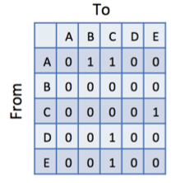
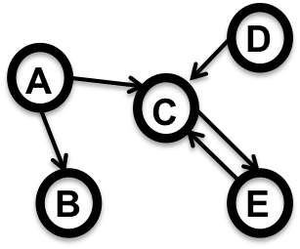
Question 4:
Draw the adjacency matrix for the following graph
Notes:
B is a

Slide 7
Question 5:
Which of the Vs BEST describes the result in constant increasing in the number of edges in a graph, sometimes causing challenges in knowing when one has found "an answer" to one's analysis question?
Valence==connectedness
Variety
Velocity
Volume

Slide 8
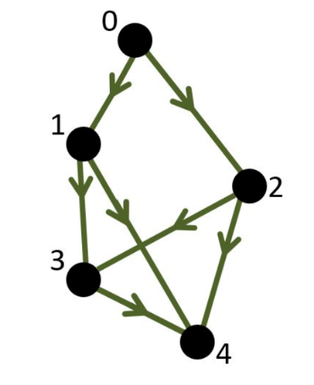
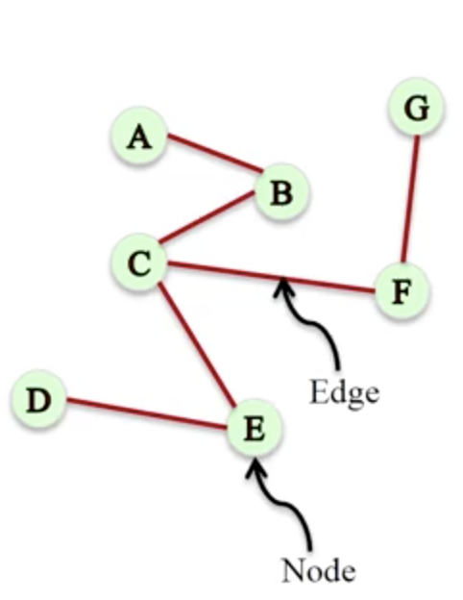
Graph Theory = Network Math Definition
Network = graph : A representation of connections among a set of objects. A graph is a set of nodes (vertices) joined by a set of lines or arrows (edge).
More formally, we define a graph G as an ordered pair G = (V,E) where
V is a set of vertices (nodes)
E is a set of edges (links).
Each edge is a pair of vertices. In other words, each element of E is a pair of elements of V.
Example: The picture above represents the following graph:
V = {1,2,3,4,5,6}
E = {{1,2},{1,5},{2,3},{2,5},{3,4},{4,5},{4,6}}
Directed/Weighted Graph
Directed Graph
Undirected Graph

Slide 9
Graph Analytics
Path Analytics
Connectivity Analytics
Centrality Analytics
Community Analytics

Slide 10
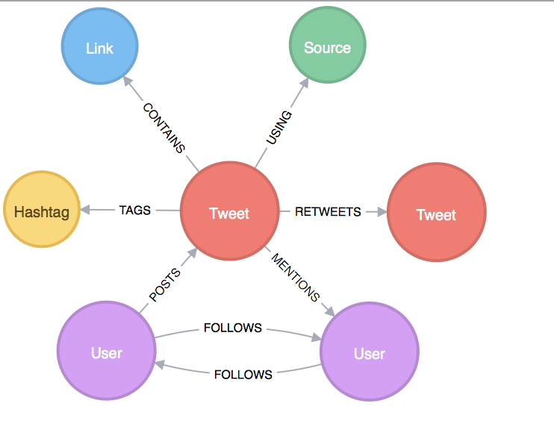
Graph of a Tweet
A real graph has more more information content
Different type of nodes
Question - Which of the following are the kinds of types, nodes in a tweet graph might have?
User
Media
Hashtag

Slide 11
Extended Graph Model
V: is a set of vertices (nodes)
E: is a set of edges (links).
TN: set of node types
f (TN → V): type assignment to nodes (labels)
AN: set of node attributes
TE: a set of edge types
g (TE→ E): type assignment to edges (labels)
AE: set of edge attributes
Node Schema = Properties (attributes) with Values
Edge Schema = Properties (attributes) with Values

Slide 12
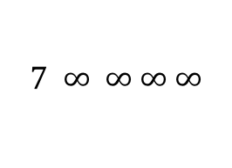
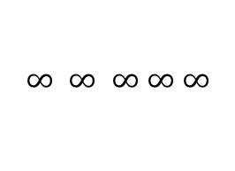
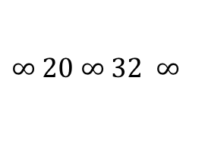

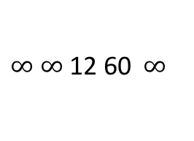
Edge Weight = an Edge Property
Distance in a road network
Strength of Connection in a personal network
Likelihood of interaction in a biological network
$∞$ $∞$ 12 60 $∞$
$10$ $∞$ $∞$ $∞$ $∞$
$∞ 20$ $∞$ $32$ $∞$
$$∞ ∞ ∞ ∞ ∞$$
$$7 ∞ ∞ ∞ ∞$$
0 1 0 0 1 0
1 0 1 0 1 0
0 1 0 1 0 0
0 0 1 0 1 1
1 1 0 1 0 0
0 0 0 1 0 0

Slide 13
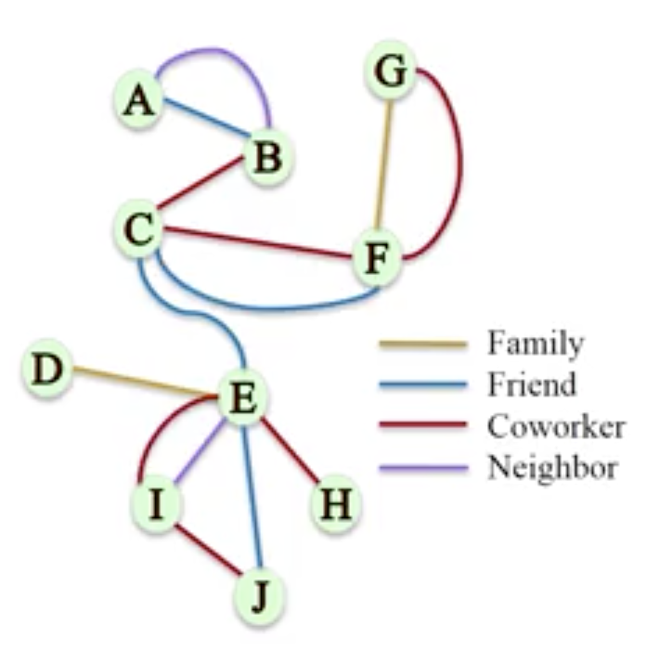
Multigraphs
A pair of nodes can have different types of relationships simultaneously
Multigraph: A network where multiple edges (parallel edges) can connect the same nodes
A loop in a graph is where ….
There is a way to get from node A to node B and back to node A
There is some (arbitrary length) path from a node back to itself, passing through other nodes
There is an edge from a node to itself

Slide 14
Path Analytics
Walk: an alternating sequence f vertices and edges over a graph.
H->F->G->C->F->E->B
Edges and nodes can be repeated
Path: A walk with no repeating node except possibly for the first and last
J->G->C->F->E->B
Constraining a walk
Cycle: a path of length n >= 3 whose start and end vertices are the same J->G->C->F->J
Acyclic: A walk with no cycle

Slide 15
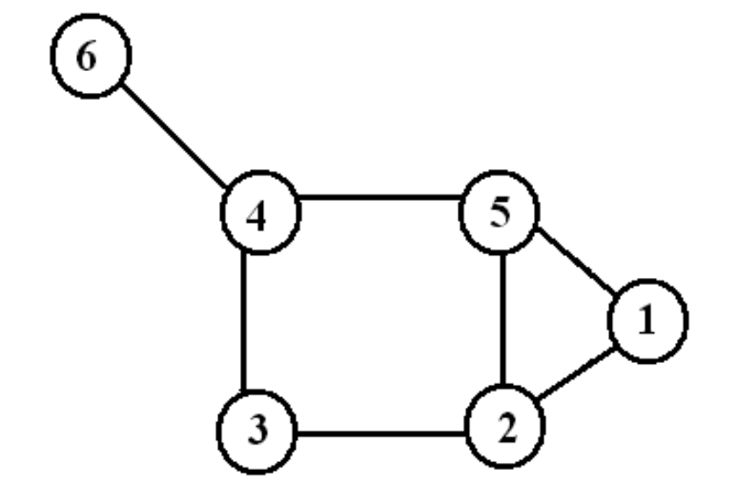
Path, Walk, Cycle
1,2,5,2,3,4 ---- Walk of length 5
1,2,3,4,6 ---- path of length 4
1,2,5,1 ---- 3-cycle
2,3,4,5,2 ---- 4-cycle

Slide 16
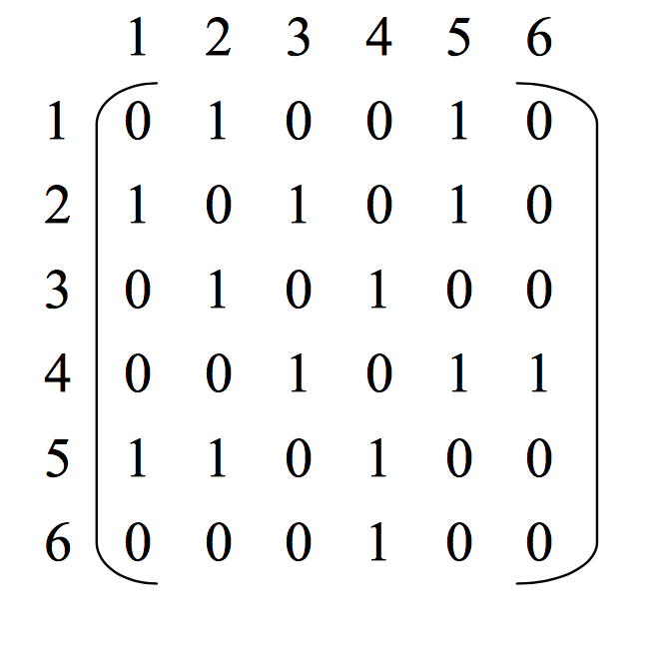
Adjacency Matrix
V x V
Boolean values (adjacent or not)
Or Edge Weights

Slide 17
Path Analytics
Trail: no edge can be repeated
Reachability: node u is reachable from node v if there is a path from v to u
B is reachable from J
J is not reachable from B

Slide 18
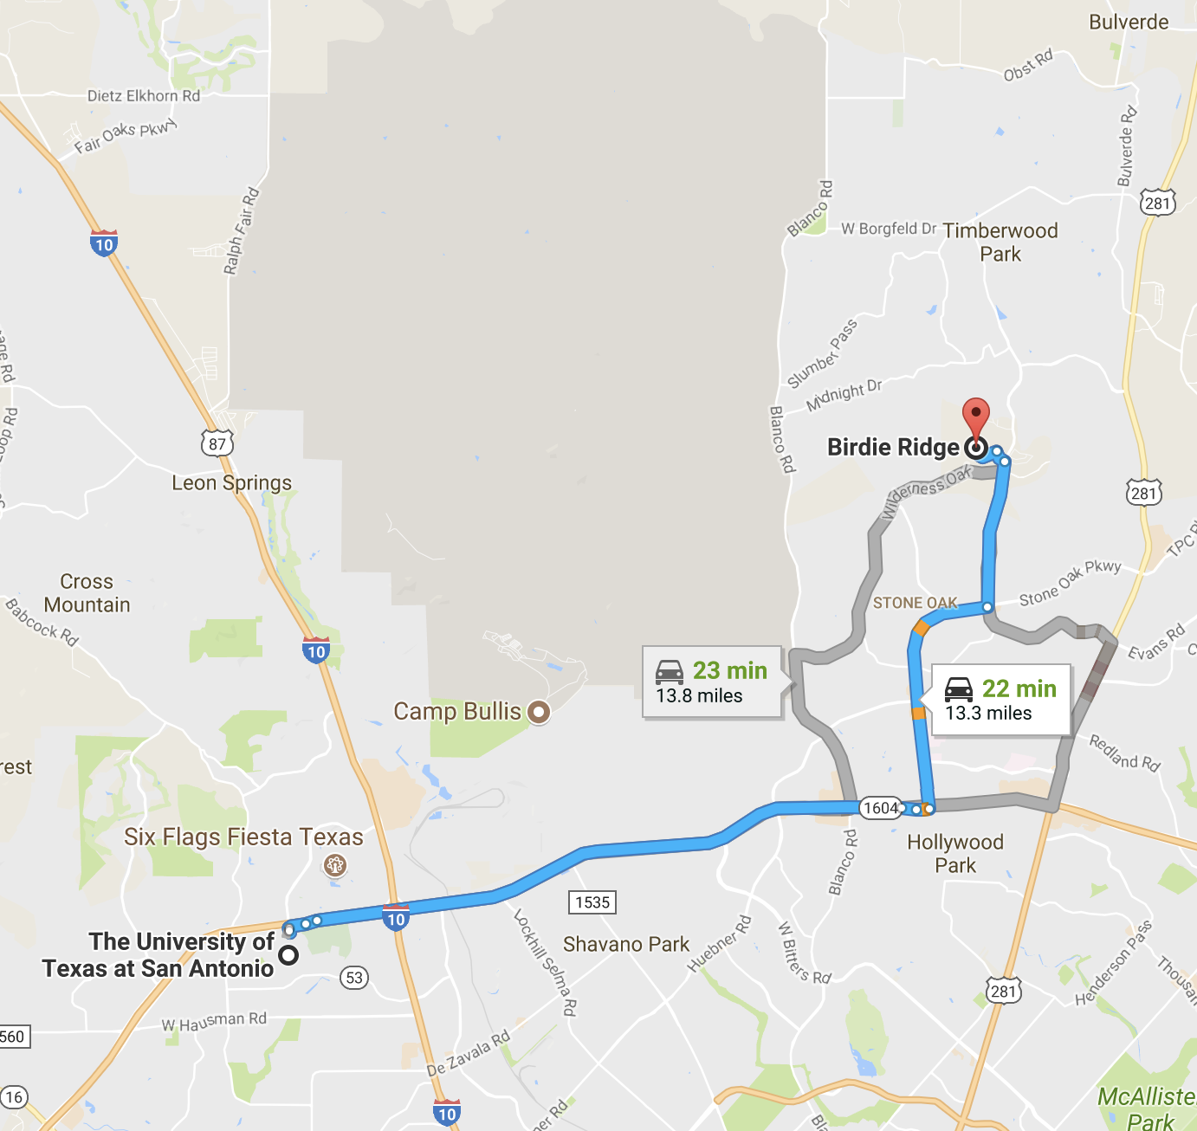
The Best Path
What is the “best” path to go from node u to node v?
Specification of “best” may include
Function to optimize
Nodes/edges to traverse
Nodes/edges to avoid
Preferences to satisfy

Slide 19
Shortest Path
Function of optimization (Simpler Problem)
Find least weight path from I to B
(Dijkstra’s Algorithm)

Slide 20
Graph Search (Breadth-first vs. Depth-first)

Slide 21
Shortest Path – Dijkstra’s Algorithm

Slide 22

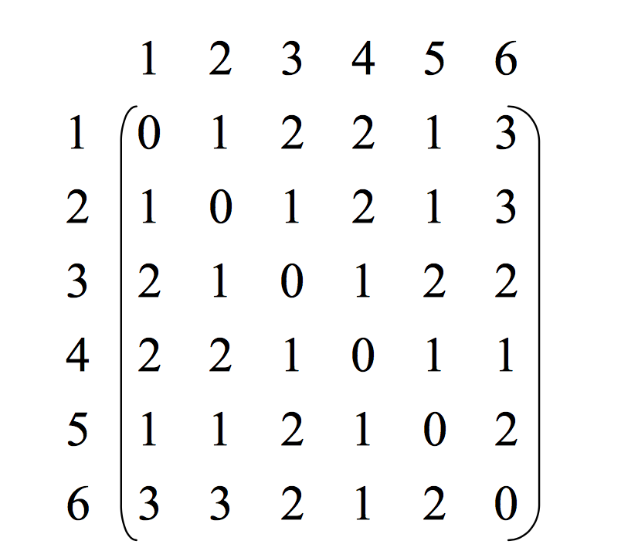
Distance Matrix
|V | x |V | matrix D = ( d ) such that dij is the topological distance between i and j.

Slide 23
Path Analytics
Find least weight path from I to B with constraints:
Nodes/edges to traverse
Nodes/edges to avoid
Example:
Avoid paths through E
Must go through J

Slide 24
Source 2

Slide 25
Graph Diameter
Diameter: the length of the “longest shortest path” between any two vertices (u,v). In other words, a graph's diameter is the largest number of vertices which must be traversed in order to travel from one vertex to another vertex.
To
From

Slide 26
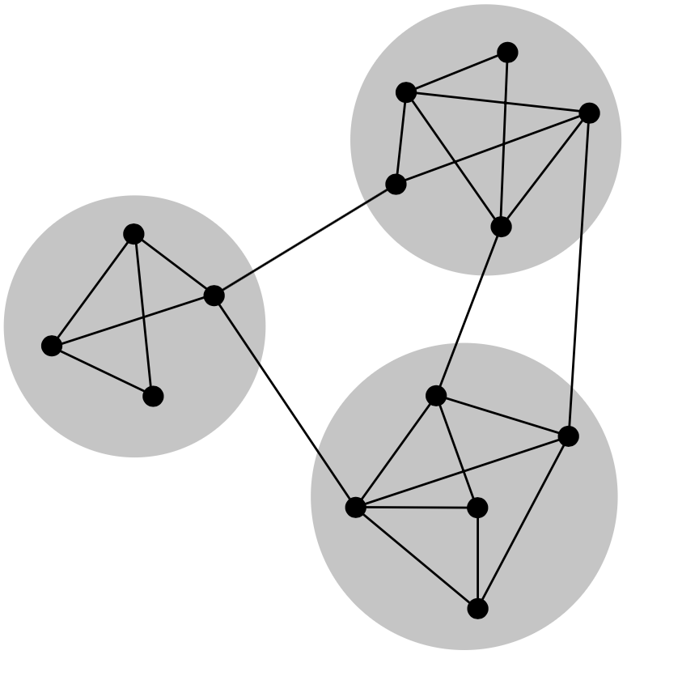
Why Graph Connectivity
Measuring Network Robustness
Estimate the connectedness of a network
Evaluate how much a structure is affected by an attack (Redundancy)
Graph Connectivity: Asks for the minimum number of elements (nodes or edges) that need to be removed to disconnect the remaining nodes from each other
Finding connected component of a graph
Strongly connected fragment(s) of a graph

Slide 27
Graph Connectivity Analysis
Connectedness: A graph is connected if it contains a directed path from u to v or a directed path from v to u for every vertex-pair (u,v)
For Directed Graphs:
Strongly connected: a directed path from every u to every v Weakly connected: connected after converting a directed graph to an undirected graph
Is this graph strongly or weakly connected?

Slide 28
Disconnecting a Connected Graph
Node Connectivity is 3

Slide 29
Disconnecting a Connected Graph
Edge Connectivity is 4

Slide 30
Network Robustness
If node v is reachable from node u originally, it should remain reachable even if the network is “attacked”
Attacked
• Node/edge removed
Degree of a node = Number of edges connected to it.
Degree of node F = 5
-- Higher degree node is makes it higher vulnerable
???
???

Slide 31
Is this network robust?
Robustness – assessed with respect to attacks Remove F (why F?)
Paths C→G, C→J, C→E, J→E, I→E disrupted
Which node should the attacker target next?

Slide 32
Indegree and Outdegree
For a vertex, the number of head ends adjacent to a vertex is called the indegree of the vertex and the number of tail ends adjacent to a vertex is its outdegree

Slide 33
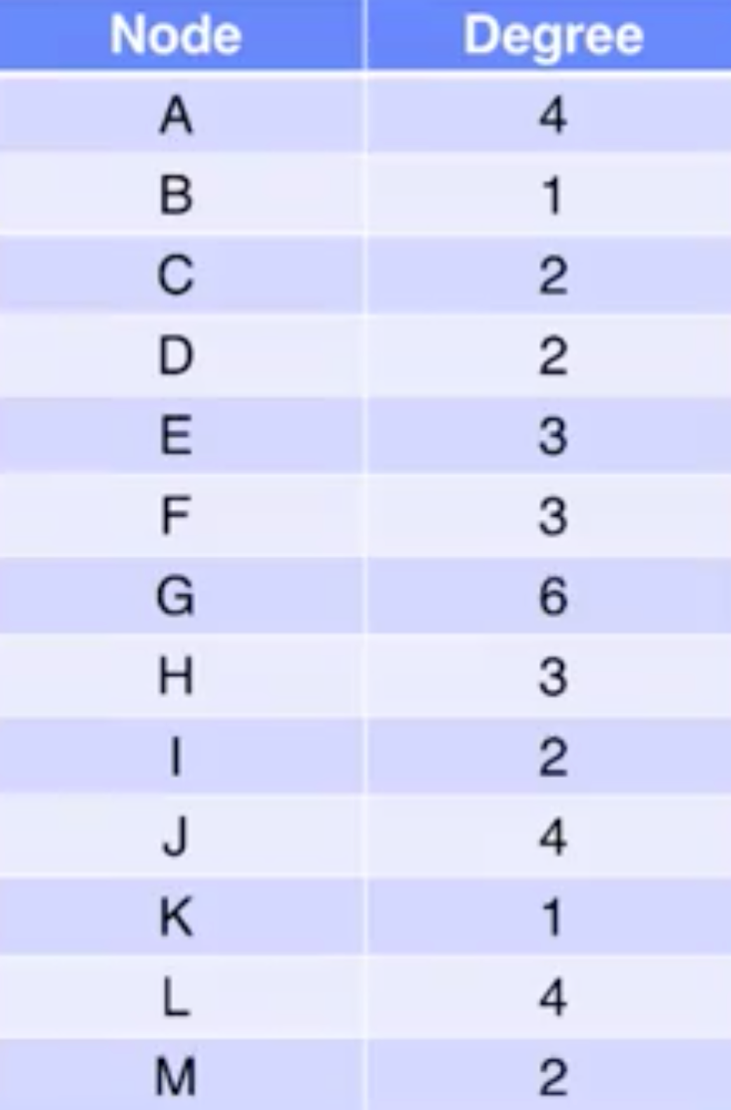
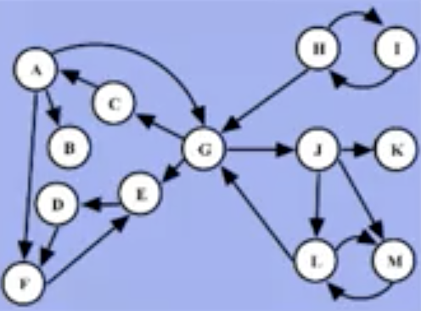
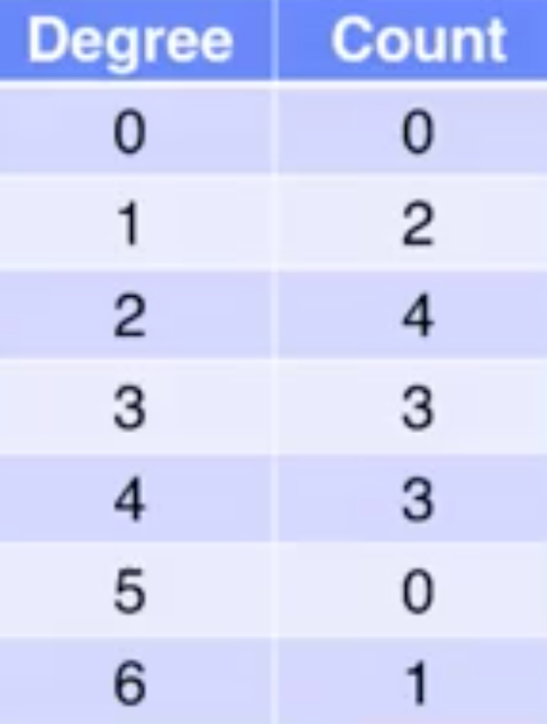
Node Degree and Histogram
Degree Table
Degree Histogram

Slide 34
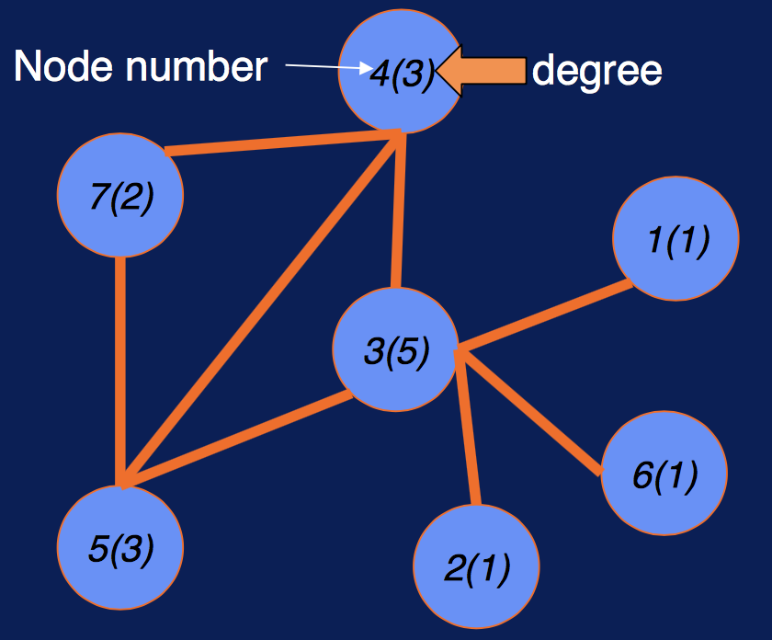
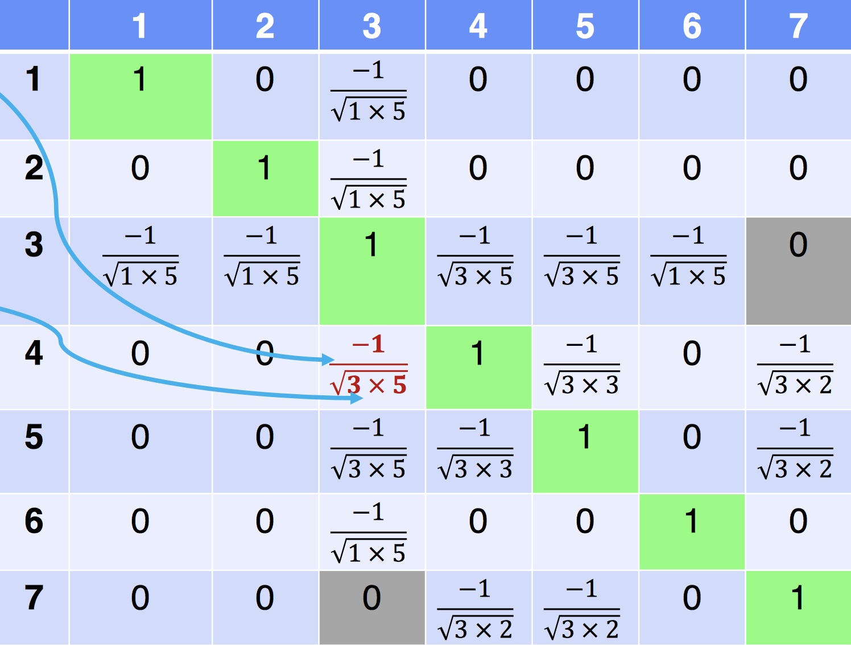
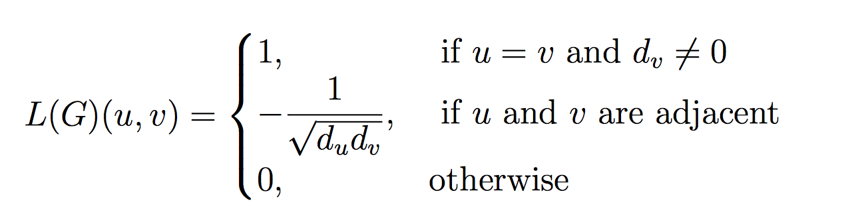
Weighted Spectral Distribution
Normalized Laplacian Matrix L – symmetric
The weighted spectral distribution (WSD) is a metric defined on the normalized Laplacian spectrum. It can be used for comparing complex networks with different sizes (number of nodes) and provides a sensitive discrimination of the structural robustness of complex networks.

